Slide 1
Algorithmic Efficiency
(Higher Level only)

Slide 2
Algorithms and efficiency
More than one algorithm may exist to solve a given problem.
We have seen how several different algorithms may be used to sort a list of numbers.
When there are different algorithms, we have to decide which to apply to a given problem. In order to do this we need a way to compare them.
A key factor when comparing algorithms is efficiency. By this we mean the amount of work done to achieve a specified task.
Less work for the same task is generally more efficient.

Slide 3
Algorithmic Complexity/Efficiency
Algorithms have both space (memory) and time (CPU utilisation) requirements
A fair way to analyse algorithms needs to be machine independent

Slide 4
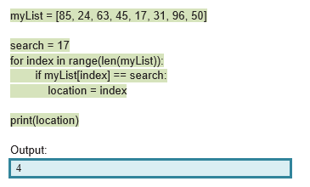
Work and Efficiency - Linear search
Let’s look at a Linear search. This involves looking through a list of items one at a time until the required item is found or the end of the list is reached. It then reports the location of the item.

Slide 5
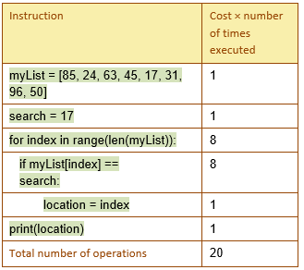
Efficiency - Linear Search
This table quantifies the work the algorithm does in terms of the number of times an instruction is carried out.
The algorithm is doing n=8 comparisons as the loop will iterate 8 times.
17 is on found once so location = index will only run once.
There are 20 operations in total.

Slide 6
Efficiency - Linear Search
If 17 were in the list twice, we would do location = index twice for a total of 21 operations.
What would be the least amount of work possible? This would occur if 17 were not in the list, in which case the line location = index would not happen at all and the algorithm would have 19 operations.
What would be the greatest amount of work? This would happen when every list item was 17 as location = index would be carried out 8 times and there would be a total of 27 operations.

Slide 7
Efficiency - Linear Search
The best case is when there is the least amount of work and this amounts to 19 operations. We can write this as 2n+3 (where n is the length of the list)
The worst case is when there is the greatest amount of work which adds up to 27 operations (or 3n +3).
The average would be in between these two.

Slide 8
Efficiency - Linear Search
The difference between best and worst here isn’t that much because we have a short list but what if the data got much bigger?
If we had a list length of 100,000,000 then n= 100,000,000 instead of just 8.
Best case would be 2n+3 or 200,000,003
Worst case would be 3n+3 or 300,000,003
We can see here that the +3 doesn’t really matter that much. The difference between 2n and 3n doesn’t actually matter that much either. What really matters is n.

Slide 9
The amount of work that an algorithm does:
can depends on the input size (n)
can depend on properties of the input data (in our example, if the list has no 17’s or all 17’s)
is not affected by small constant numbers such as +3 in our example.
We can estimate the amount of work that an algorithm does as a function of the input size n.
Computer Scientists tend to base their estimates on the worst case scenario as this requires the most time.

Slide 10
Linear Complexity
In our Linear search example, the amount of work done is n. If the input size doubles, the work also doubles.
This is known as linear complexity because the amount of work done is linearly proportional to the input size, n.
If you plotted it, you would get a straight line.

Slide 11
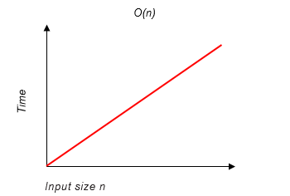
Big O notation
Big O notation can be used to describe the time complexity of an algorithm. This notation always features n, the input size.
For example, Linear search is an O(n) algorithm. This means that the time taken for the algorithm to complete is linearly proportional to the input size n.

Slide 12
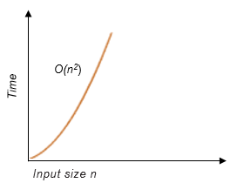
Equivalence classes group algorithms that have an equivalent complexity.
Some classes are less complex than O(n) and some are more complex.
O(n²) is a more complex equivalence class than O(n). Algorithms in this class have a quadratic complexity. This means that is grows in proportion to the square of the input size. If we double the input size, the output quadruples.
An example of an algorithm that belongs in the O(n²) class is a bubble sort.

Slide 13
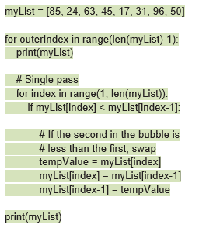
An example of an algorithm that belongs in the O(n²) class is a bubble sort.
The easiest way to think of it is, if the code needs two loops (the bubble sort on the right has a nested for loop) then it must have a worst case of n².

Slide 14
Efficiency Quicksort
A quicksort involves picking a pivot and forming two sublists and then calling quicksort recursively on each sublist.
The worst case would be where we pick a pivot value that is greater than all the other values. This would result in two sublists - one of length 0 and one of length n-1. To get to this stage, n-1 comparisons were required as the pivot value would need to be compared with all other values.
Next, the quicksort function is called on the unsorted sublist of length n-1. A new pivot is needed and again the worst case scenario is if the two new sublists were of lengths 0 and n-2. Getting to this stage would require n-2 comparisons.

Slide 15
Efficiency - Quicksort
In general, the first step required n-1 comparisons, the second requires n-2 comparisons and so on. This is repeated until we reach step n, when we need n-n or 0 comparisons.
The total number of comparisons will be: (n-1) +(n-2) +...+(n-n)
(n-n) = 0, leaving (n-1)+(n-2)+...+(n-(n-1)). But (n-(n-1)) is equivalent to 1. Similarly (n-(n-2)) is equivalent to 2.
So we can simplify the total comparisons to (n-1)+(n-2)+ …+2+1

Slide 16


Efficiency - Quicksort
There are n-1 terms to be added together so if we rearrange we can write our total as: (n-1) + 1 + (n-2) +2 etc.
(n-1) + 1 = n. (n-2) + 2 = n. Each pair will equal n. There are (n-1) numbers in total, giving pairs which are each equivalent to n.
Our total can be rewritten as
From our previous examples, the constants and lower order terms are not significant so we are left with n²
The worst case time complexity for quicksort is O(n²)

Slide 17
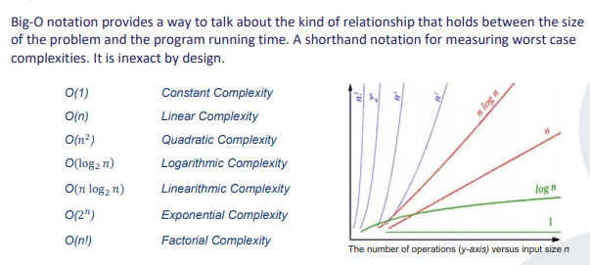

Slide 18
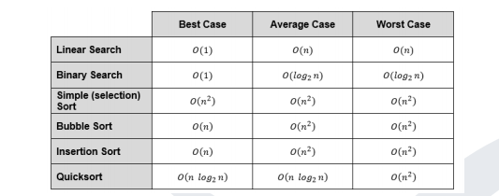
Algorithmic Efficiency
Note: O(1) means that you would only be searching the first item in the list

Slide 19
O(n) means that the time taken for the algorithm to complete is linearly proportional to the input size n.
O(n²) means that the time taken for the algorithm to complete grows in proportion to the square of the input size (n). If we double the input size, the output quadruples.

Slide 20
Heuristics
There are many problems that are considered intractable - This means that no algorithm exists that can solve them in a reasonable amount of time (years or less, depending on the problem).
One such problem is the travelling salesperson problem. A salesperson needs to visit n towns but the problem is which route, visiting all of the towns and then returning to the starting point will cover the least distance?
WIth 30 cities, there are 2652528598121910586363084800000000 combinations. It would required a computer many millions of years to check all of these.

Slide 21
Heuristics
Often a heuristic is used to solve problems such as this. A heuristic algorithm is not guaranteed to return the exact answer but one that is sufficient.
It is thought of as a “rule of thumb” or educated guess which allows us to produce an approximate but useable solution to a problem.
They are strategies derived from previous experiences with similar problems.
They are suitable when finding an optimal solution is impractical or impossible.

Slide 22
Heuristics are not guaranteed to be optimal (but usually take less time than would be required to find an optimal solution).
Limitations lie in the trade-offs e.g. correctness vs. performance. Suitable when finding an optimal solution is impractical or impossible.

Slide 23

A few commonly used heuristics from George Pólya’s 1945 book, How to Solve It:
If you are having difficulty understanding a problem, try drawing a picture.
If you can’t find a solution, try assuming that you have a solution and seeing what you can derive from that (“working backward”)
If the problem is abstract, try examining a concrete example.

Slide 24
What is the difference between best case and worst case scenarios in an algorithm with respect to the amount of work done?
Why do computer scientists base estimates of work done by an algorithm on the worst case scenario?
What does algorithmic time complexity measure?
What is the only factor that computer scientists consider when looking at algorithmic complexity?
What is meant by linear complexity?
What is meant by “Big O” notation?
What are equivalence classes of algorithms?
Give an example of an algorithm that belongs in the O(n) class.
Give an example of an algorithm that belongs in the O(n²) class.
Explain what is meant by “Intractable” problems.
What is a heuristic?
When are heuristics useful?

